Slide 1
Promoting the 2026 Maternity Survey
Engagement webinar

Slide 2



Contents
Overview of the Maternity survey
  Overview
  Performance monitoring and evaluation
  Publication of MAT25 results
  Response rates 2007 - 2024
Engagement Activities
  Publicising the survey
  Publicising the results
2026 Engagement Activities
  Press release template
  Website banner
  Dissent poster
  16-17 year olds leaflet
  Social media cards
  Publicising the survey: discussion
  How can you help us?
  Timeline of activities
  Questions

Slide 3
Overview of the Maternity Survey

Slide 4
Overview
One of the five experience surveys of the NHS Patient Survey Programme (NPSP)
Conducted almost every year since 2007:
  Receives responses from thousands of maternity service users each year
  Looks at the experiences of maternity service users across the maternity pathway
  Results are crucial to monitoring performance and improving the quality and safety of maternity care across NHS trusts
2025
Number of trusts:
119 Trusts
Sample:
All births within February sampled (going back into January for smaller trusts)
Push-to-web approach:
Mixed mode, with paper and SMS reminders
Translations:
Translated into 9 online languages, with 10 more available via Language Line
Accessibility:
Large print, Easy Read and Braille versions available
Eligibility:
Live birth in sampling period and aged 16 or over

Slide 5
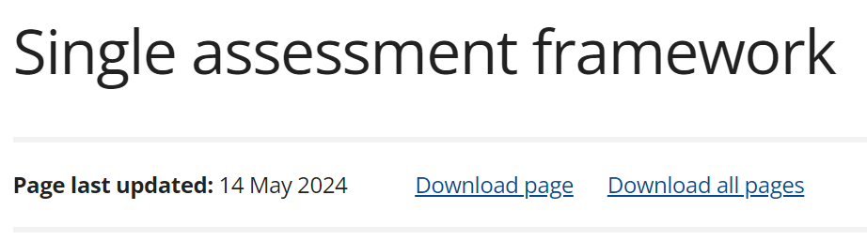

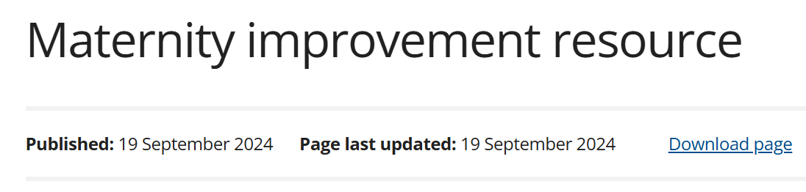


Maternity Survey: performance monitoring and evaluation
Trust level data analysis and reporting
Used by individual NHS trusts and Integrated Care Systems (ICS) to:
  Incorporate service user experience into decision-making
  Identify areas they are performing well and areas for improvement
  Monitor progress over time
  Used by the Maternity and Neonatal Voices Partnerships (MNVPs) who work with trusts and Integrated Care Boards (ICBs) to support action planning for service improvement
The Care Quality Commission (CQC) uses the results to assess NHS performance and for use within inspections
This includes highlighting where there are safety concerns or examples of good care:
  CQC’s Single Assessment Framework
  CQC Maternity Inspection Programme & Maternity improvement resource
  The State of Health Care and Adult Social Care in England 2023/24

Slide 6



Maternity Survey: performance monitoring and evaluation
Results can also be used by trusts to:
Educate & train
Support education and training for staff.
Share results
Share trust level results with the board.
Improve
Identify priority areas for improvement.

Slide 7
Maternity Survey: performance monitoring and evaluation
Results are also used by a range of national stakeholders:
NHS England
Third sector organisations
Department of Health and Social Care

Slide 8

Publication of MAT25 results
8
December
2025
*Due to national statistic restrictions, we cannot discuss findings until publication date*

Slide 9
Response rates: 2007 - 2024
9

Slide 10
Engagement Activities

Slide 11



Publicising the survey: why is it important?
Encourages service users to participate
  Increased representation within the data
  Provides service users with a voice and opportunities to share their feedback with trusts
  Helps to maintain / increase response rate
Increases cases for analysis
  Providing data for more questions at trust and site level
  Sub-group analysis: more cases allows breakdown by ethnicity or long-term conditions as currently some subgroups are suppressed due to a low number of respondents
  Reduces the possibility of suppression
For further information:
  https://nhssurveys.org/survey-instructions/publicising-surveys/

Slide 12


Publicising the survey: methods for publicising
2025:
  Press Release Template
  Four Social media cards
  Website banner
  Dissent poster / leaflet
Changes for 2026:
  Social media cards schedule: re-publication of cards to boost exposure
  Social media cards: sharing of cards with MNVPs to increase engagement

Slide 13
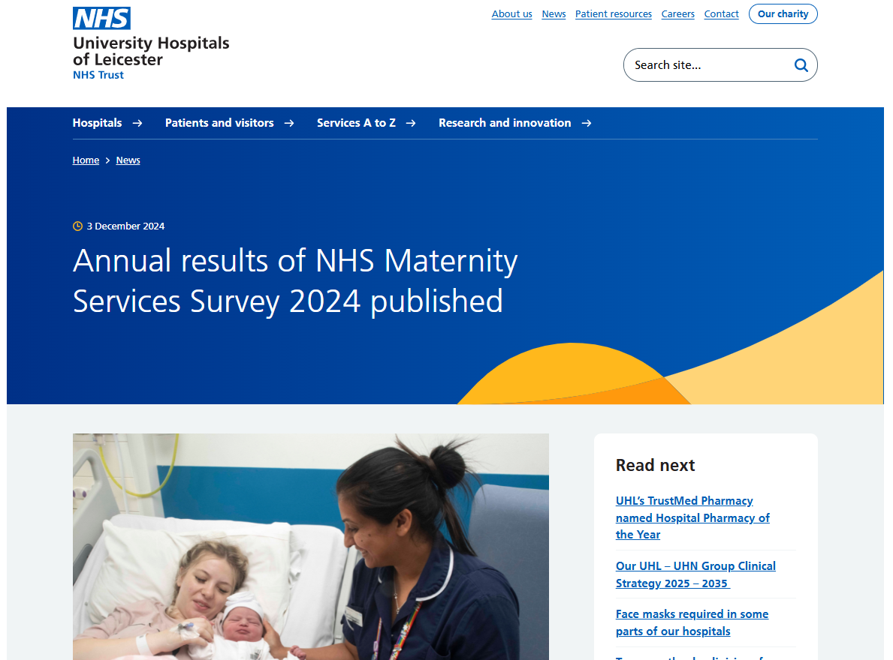
Publicising the results: Trusts

Slide 14
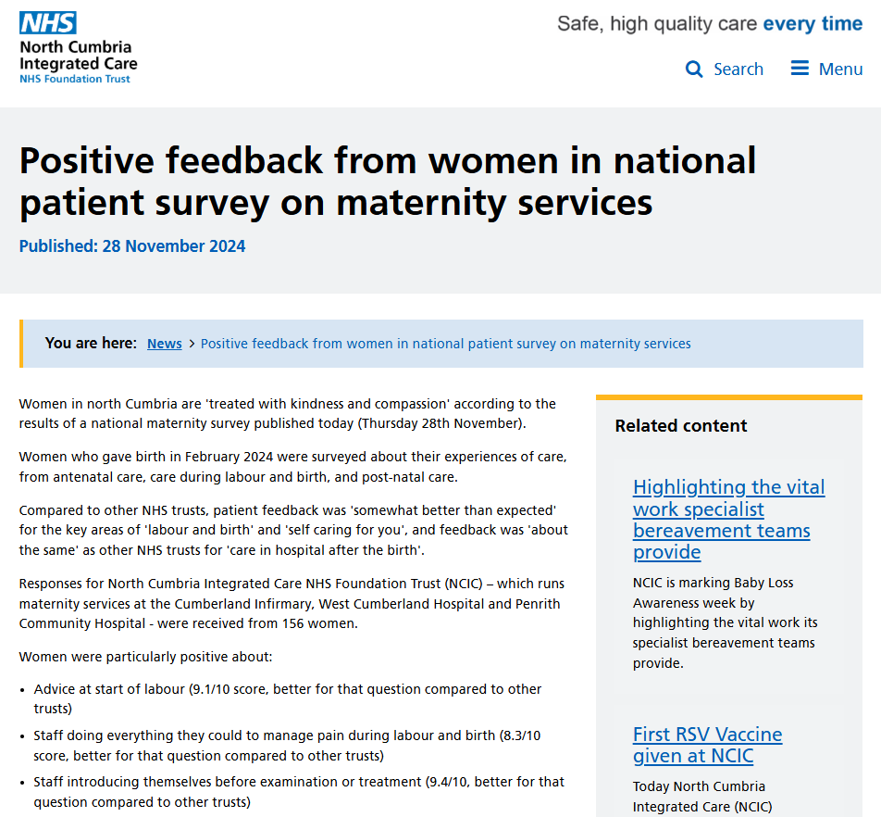
Publicising the results: Trusts

Slide 15
2026 Engagement Activities

Slide 16
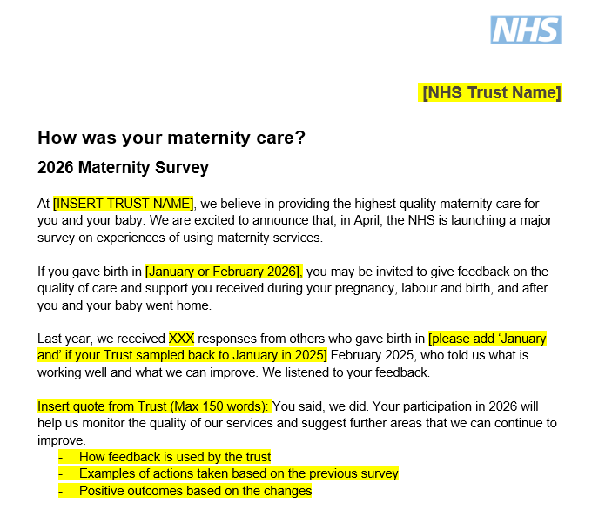
Press release template
The template explains:
  Purpose and value of participation
  What happens to feedback
  Information on how to participate
  Placeholder for trusts
How to use it:
  Publish in your regular newsletters
  Upload to your trust’s ‘news’ page

Slide 17

Website banner
How to use:
Across all your social media platforms
Add to your trust’s website
Include in service user materials (e.g. e-bulletins)

Slide 18

Dissent poster
Purpose:
  Makes service users aware of the survey
  Provides an opportunity for them to ask questions or opt out
  Requirement for CAG approval
How to use it:
  Display printed copy on noticeboards
  Display digital versions on TV screens

Slide 19
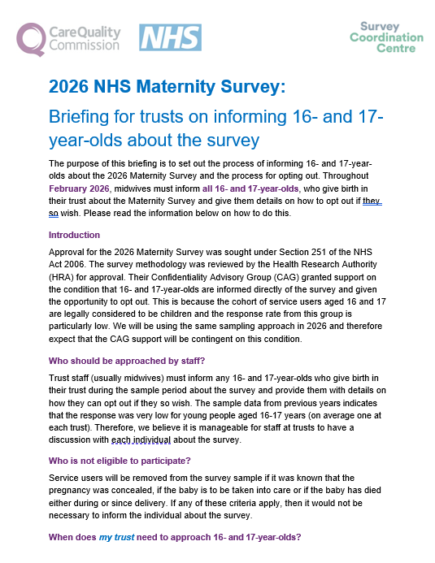
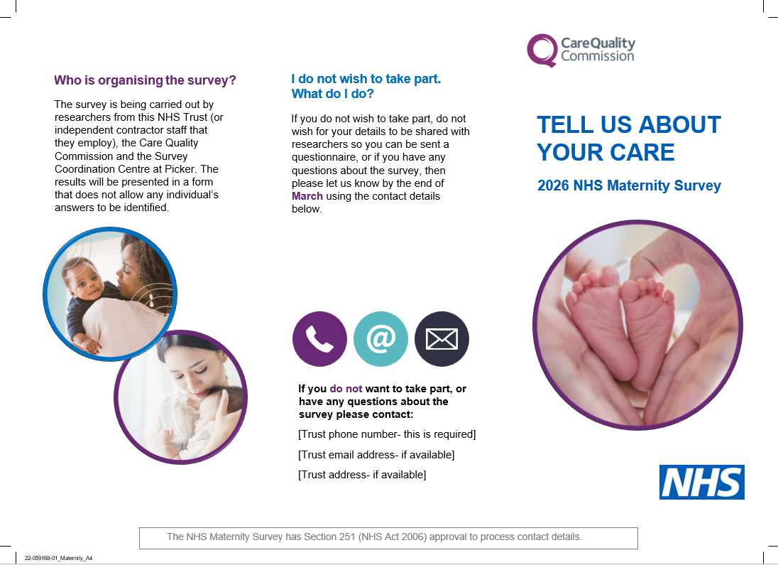
16-17 year olds leaflet & briefing note
The leaflet & briefing note:
  Provides an opportunity for all 16-and-17 year olds who give birth to ask questions or opt out
How to use it:
  Should be provided to all 16-and-17 year olds who give birth in your trust

Slide 20


Social media card 1: Sampling month
How to use:
Share with service users who could be included in the sample
Share across all your social media platforms
Print and share as handout to service users who had a live birth
Distribution in postnatal wards in hospital
Add to waiting room TV screens

Slide 21

Social media card 2: Announcing the start of fieldwork
How to use:
Share across all your social media platforms
Ask your comms team to pin it on their social media for the first two weeks of fieldwork and / or reshare it in mid-May
Print and share as handout to service users during postnatal appointments

Slide 22

Social media card 3: Reminder that fieldwork is live
How to use:
Share across all your social media platforms
Ask your comms team to pin it on their social media for the first two weeks of publication in June and / or reshare it later in June
Share via newsletters

Slide 23

Social media card 4: Reminder about the close of fieldwork
How to use:
Share across all your social media platforms
Ask your comms team to pin it on their social media until the end of fieldwork
Share across any channel appropriate for patient engagement

Slide 24
Publicising the survey: discussion
Questions for you:
  Did you use the social media cards in 2025?
    If so, how did you use them?
    What other channels have you used to promote the survey?
  How can we support you in publicising the survey?
    Is there anyone else in your organisation we should contact / share the social media cards with?
    Other activities to specifically target your populations?

Slide 25
Publicising the survey: discussion
Questions for you:
  What do you think about the social media cards?
  What do you think about the proposed timeline for publishing and sharing the social media cards?
    Do you think it would be useful to re-post each social media card to increase exposure?

Slide 26
Publicising the survey: discussion
Questions for you:
  Are there any other materials you would find useful? Any other formats?
  Is there anything we’re presenting that won’t work for this group?
  Is there anything we could do differently?

Slide 27

How can you help us?
Share the Press Release with your audience to raise awareness about the MAT26 survey.
Share the Social media cards prior and during fieldwork:
  On your social media
  With your comms team, who can pin and re-share
  In your correspondence (e.g. via emails)
  On waiting room TV screens
  Involve MNVPs
Promote the survey to your audience, including the Website banners in your correspondence.

Slide 28
Timeline of activities
Activity | Date
Service user interviews | October 2025
Confirm who your contractor is | December 2025
Share Press Release template | December 2025 - February 2026
Section 251 approval | January 2026
Display dissent posters | January – February 2026
Share 16-17 year olds leaflet | January – February 2026
Share Social media card 1 | December 2025 – February 2026
Use Website banner | January – July 2026
2nd Trust webinar | February 2026
Trusts to draw samples | March 2026
Share social media cards 2 & 3 | April – July 2026
Fieldwork | April – July 2026
Share social media card 4 | July 2026
Analysis | August – Autumn 2026
Publication | Autumn 2026

Slide 29
Questions

Slide 30
Thank you for your time
If you have any further thoughts or any queries, please contact us at:
maternity@surveycoordination.com
01865 208127
Maternity survey website:
https://nhssurveys.org/surveys/survey/04-maternity/

